Slide 1
Strict Reasoning for the Versatile World
Ariadna Barinova
Scientific advisor: Dr. Cyril Pshenichny
ITMO University
St. Petersburg, Russia

Slide 2
Representation of dynamic knowledge
Consider the notion: When bus comes people at the bus stop stand up
We deal not with relations between the objects: bus, to come, people, stop, to stand up…
…but between the events: bus comes -> people stand up

Slide 3
Event bush
Recently developed formalism for representation of dynamic knowledge
Result of an attempt to create a more or less strict conceptual model in geosciences, but with a good perspective to become a formal theory (logical or alike)
Simple enough to allow an engineer to use it for research needs as well as for everyday issues

Slide 4
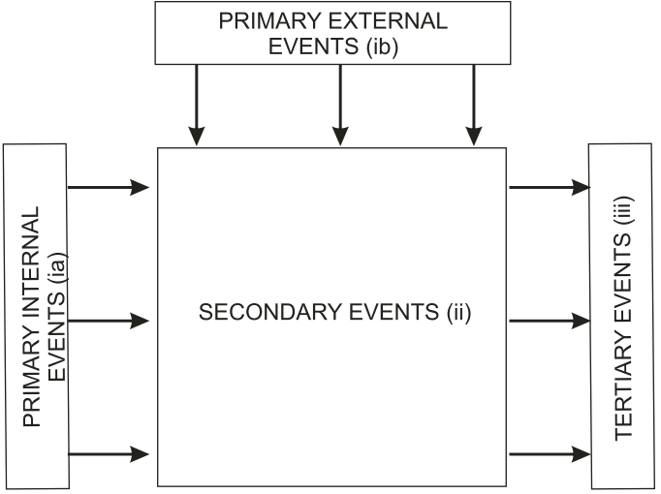
The principles
ia. Primary internal events. These are primary, nonunique inputs representing the “passive conditions”. These would determine any further course of events (“happenings”);
ib. Primary external events. These are the “invading agents”. They may affect basic inputs or inﬂuence their further, indirect manifestations, thus “shaping” different “happenings”;
ii. Secondary events that result from primary internal inputs with or without the contribution of primary external ones — the “happenings” proper formulated in a strict concise way indicating their core features determined by the causes, following the principle “one more cause — one change of event”;
iii. Tertiary events that denote end results, or products, generated either by primary internal or by secondary events, with or without primary external ones. Tertiary events document the completed “happenings”.
Theoretical foundations of the event bush method. Architecture of the Event Bush.
Pshenichny and Kanzheleva, 2011.
Figure 1. Multiﬂow structure of the event bush.
Pshenichny and Kanzheleva, 2011.

Slide 5
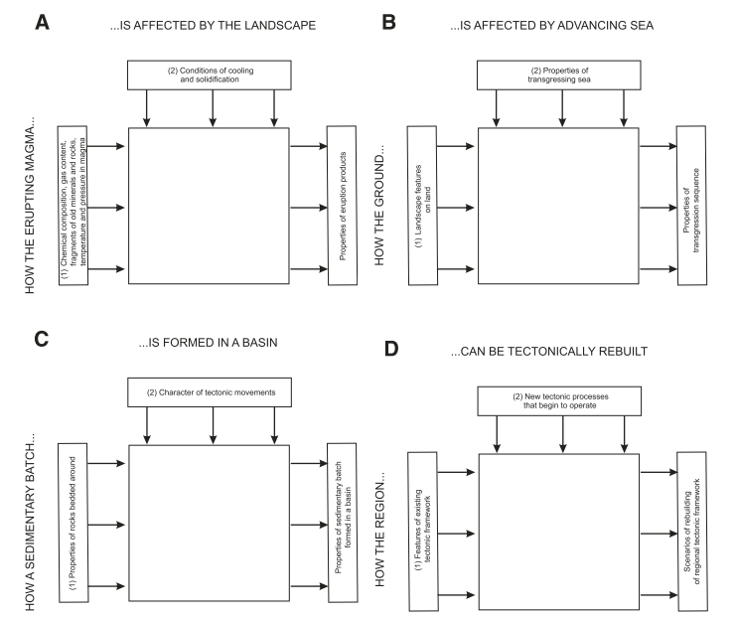
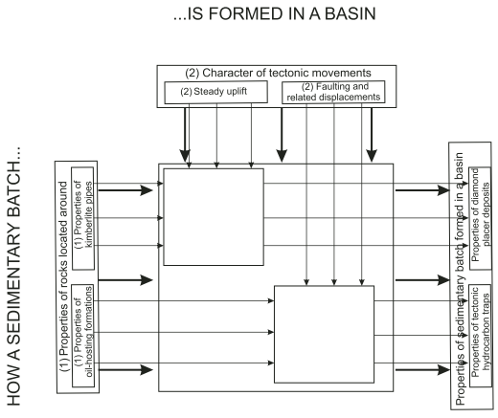
Examples
Figure 2. Anatomy of geoenvironments of alternative directed changes by four various examples.
Pshenichny and Kanzheleva, 2011.
Figure 3. Example of “nested” (self-similar) geoenvironments.
Pshenichny and Kanzheleva, 2011.

