Slide 1
Ph.D thesis presentation An approach to measuring SW systems through combined testing metrics
Sarah Dahab Supervised by Stéphane maag
Started on March 2016
Notes:
I am going to present my PhD thesis : titre
Started on march and supervised by

Slide 2
Plan
Context
Problematics
Thesis purposes
Our framework
Working progress
Notes:
First i will present my thesis context
Then, the problems that we will try to level
Then i will explain solutions we purpose
And i will finish by the conclusion

Slide 3
Context
Software measurement
Greater marketing of software
More complex systems
High demand for adapted measurement
Current metrics are no longer adapted
Lots of data to analyze
European project MEASURE
Measuring Software Engineering
Increase the quality and efficiency
reduce the costs and time-to-market
Notes:
The context of my thesis is the software measurment.
Nowaday the software marketing is growing and systems are more complex
Thus there is a high need of adapted measurement
However actual metrics are no longer adapted to meet this need
And the data to analyze become to high
It is in this context that the european projet Measure goes ahead. Its goals are increasing the … and reducing the ..
And my thesis takes part on this MeASURE project.

Slide 4
Problematics
Binding analysis ➔ depends on expert
Difficulties to find failure causes ➔ need architecture expert
Sequential measurement determined at the begining
Trace analysis
Notes:
So The issues that i am going to handle are
The binding site to need an expert to analyse and to find the failure causes
Also the passive measurement
And the analyse at the end of the developement process

Slide 5
Thesis purposes
Learning based Measurement Approach
Smart measurement analysis
Semi supervised algorithm
Software measurement dataset
Measurement interpretation
Determine measure pivots based on its metric on which it belongs
Intelligent metric recommendation
Associate a measure to a metric(s) ➔ model of metric correlation
@runtime in continuous way
Measurement information in real time
During full development process
Notes:
So to address these issues

Slide 6
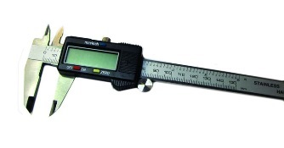
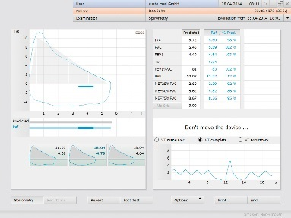
Our framework
Metric 3
Metrics Models
Measures 1
Metric 2
Software
Measurand
Measurements
Metric 1
Measures 2
Analyses
SVM semi – supervised, ML
@runtime
Measures 3
Measurements analysis
Metric recommendation: metrics correlation/refinement
Notes:
When actualy the software measurement follows a sequential process
Our approach will follow an autonomous @runtime and smart measurement cycle

Slide 7
Working progress
Green SW metric modeled in OMG standard SMM
The Computational Energy Cost metric
C. Seo, S. Malek, and N.Medvidovic. Estimating the Energy the Energy Consumption in Pervasive Java-based Systems. In Proc. of the IEEE International Conference on Pervasive Computing and Communications, PERCOM’08, USA, 2008
Position paper on our framework published in IEEE MEGSUS 2016
Notes:
Nowaday i have studied greens metric and modeled the with the SMM standard and used it for the position paper published in IEEE megsus conference

Slide 8
Bibliography
L. Ardito, G. Procaccianti, et al., Understanding green software development: A conceptual framework. IT Prof., 17(1), 2015
ISO/IEC25010: Systems and software engineering -- Systems and software Quality Requirements and Evaluation (SQuaRE) -- System and software quality models, March, 2011
P.Bozzelli,Q.Gu and P.Lago, A systematic literature review on green software metrics. VU University, Amsterdam, 2013
I.H. Laradji et al., Software defect prediction using ensemble learning on selected features. Inf. and Soft. Technology, 58, 2015
Manjula.C.M. Prasad, et al., A Study on Software Metrics based Software Defect Prediction using Data Mining and Machine Learning Techniques, Int. J. of Datab. Th. and App., 8(3), 2015
C. Zhang and A. Hindle, A green miner's dataset: mining the impact of software change on energy consumption. In : Proceedings of the 11th ACM Working Conf. on Mining Software Repositories, 2014
K. Bennett, A. Demiriz et al., Semi-supervised support vector machines. Advances in Neural Inf. processing systems, 1999
OMG, Structured Metrics Meta-model (SMM), version 1.1.1, http://www.omg.org/spec/SMM/1.1.1/, April 2016
ITEA3 MEASURE project, http://measure.softeam-rd.eu/, 2015

Slide 9
Thank you for your attention
Questions ??

